Slide 1
Build a Custom Workload Dashboard BY Netanel Ferdinaro

Slide 2
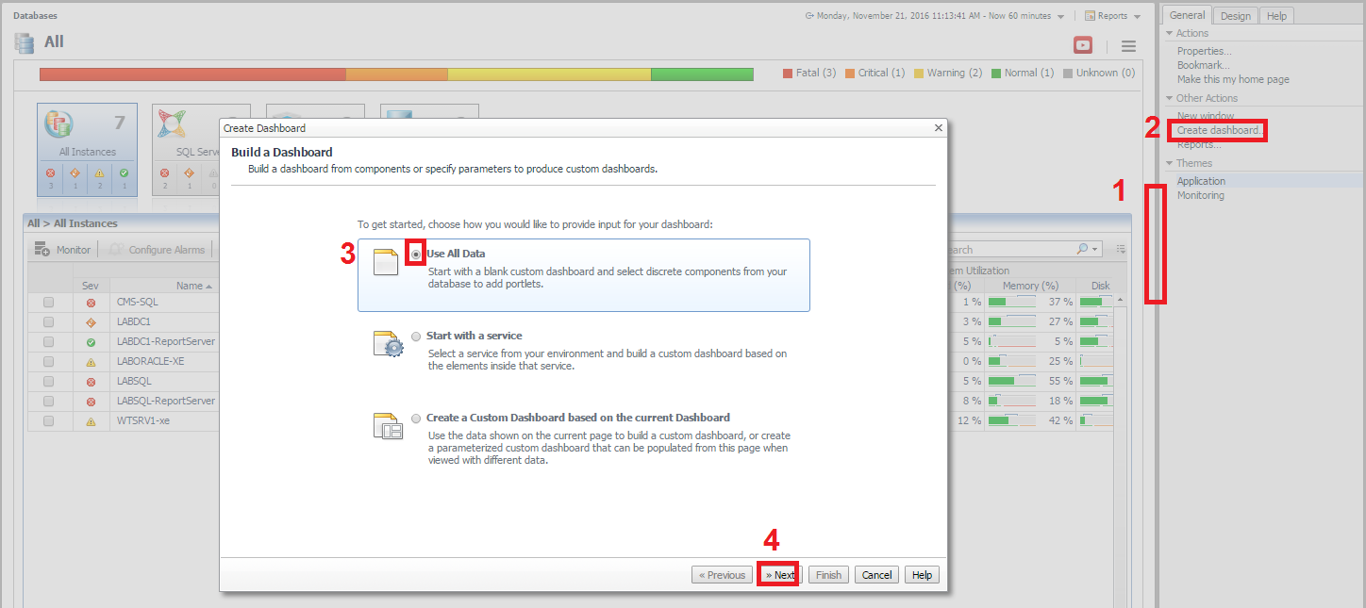
Click on the right (“hidden”) pane→ Create dashboard→ Use All Data→Next

Slide 3
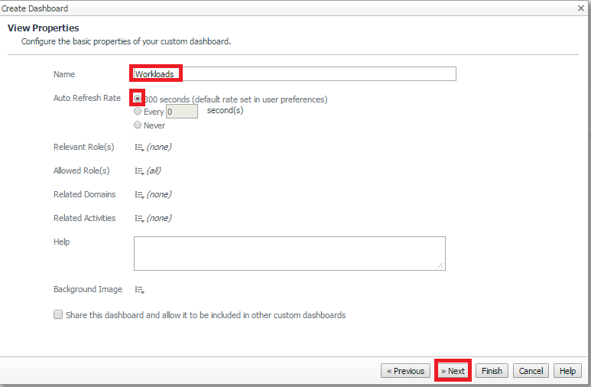
Add Name for your dashboard→ Auto refresh Rate: choose 300 sec→ Next

Slide 4
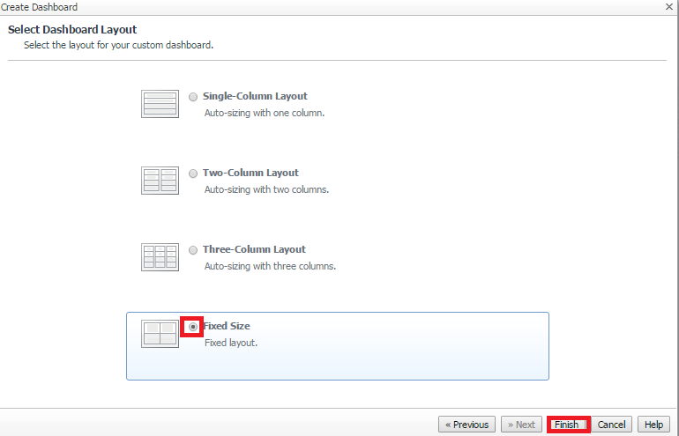
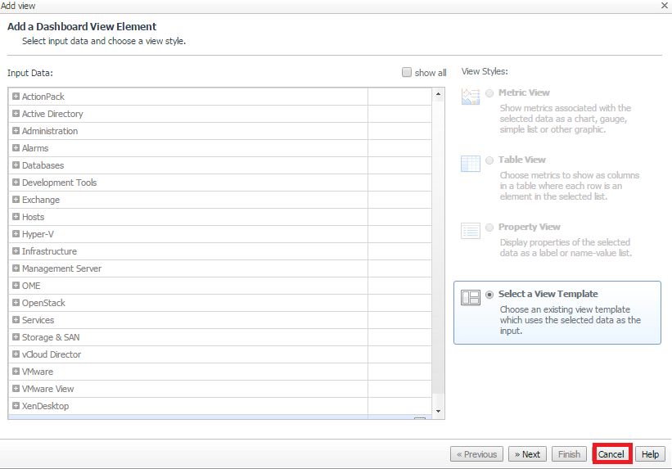
Fixed Size → Finish
This window will pop up Click On Cancel

Slide 5
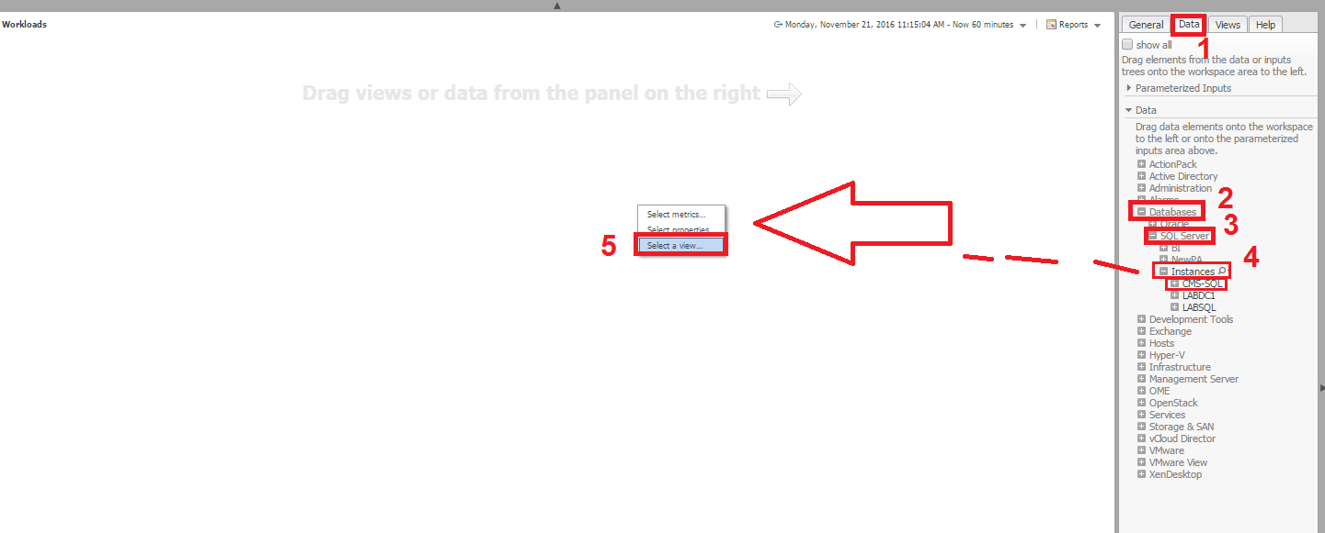
In the right pane Click on Data→Databases→SQL Server→Instances→
Choose one of your Instances and Drag it to the center→ than click on Select a view…

Slide 6
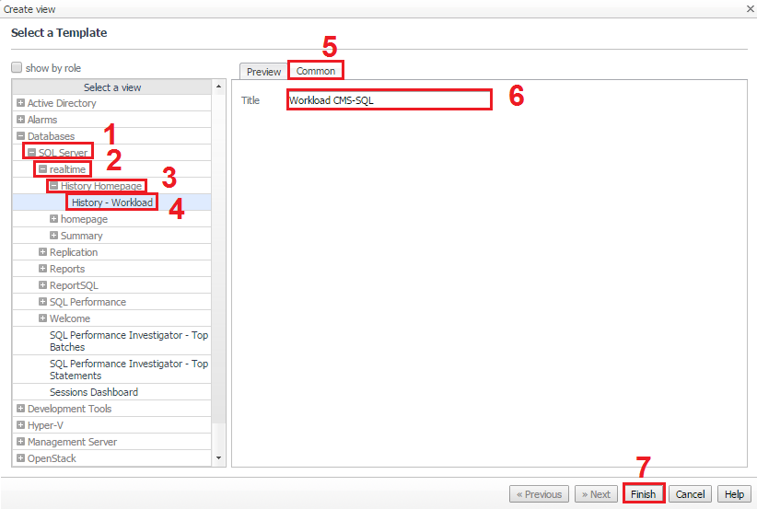
Choose SQL Server→ realtime→History Homepage→ History – Workload→ click on Common→ Name a Title for this view → Finish

Slide 7
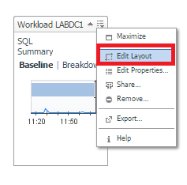
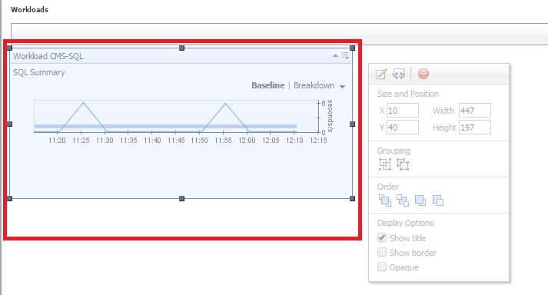
Click Edit Layout→ edit the size and the position of this View

Slide 8
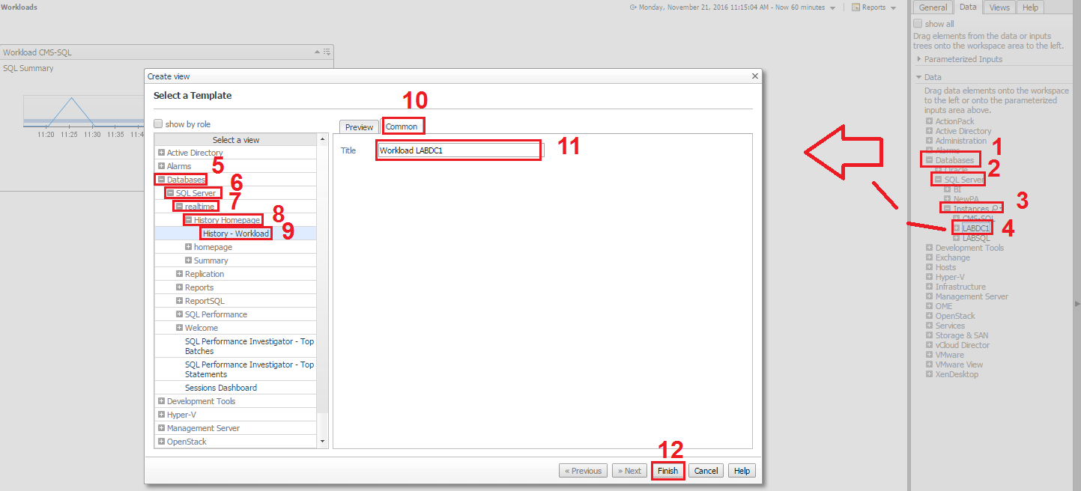
You can do it again for a different Instance on the same Dashboard

Slide 9
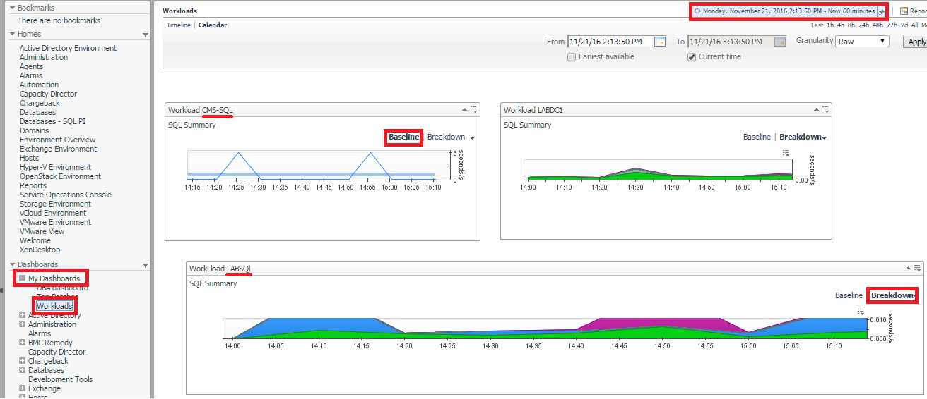
Here is an example for the Dashboard that we created.
You can access it from the left pane on My Dashboards→ (Dashboard name)
You can see the Baseline and the Breakdown of each Instance
You can see the history of the Baseline from the Calendar

